Slide 1
July 1st, 2020
Adverbs of manner
7th

Slide 2
Class rules
Para participar, pide la palabra en el chat
Los micrófonos deben permanecer apagados
El chat solamente debe ser utilizado para temas de la clase y en el momento que se indica.
Para un buen ambiente y participación, mantener las cámaras encendidas.
Nuestro clima de la clase lo creamos entre todos, hagamos que aprender sea una experiencia fantástica.

Slide 3
Welcome to week 13
Today we are going to keep working on Adverbs of Manner
In this class, we will :
Learn the rules to transform an adjective into an adverb
Organize our adjective/adverb vocabulary
For this class we will need:
Pencil and eraser
Our English BuJo

Slide 4
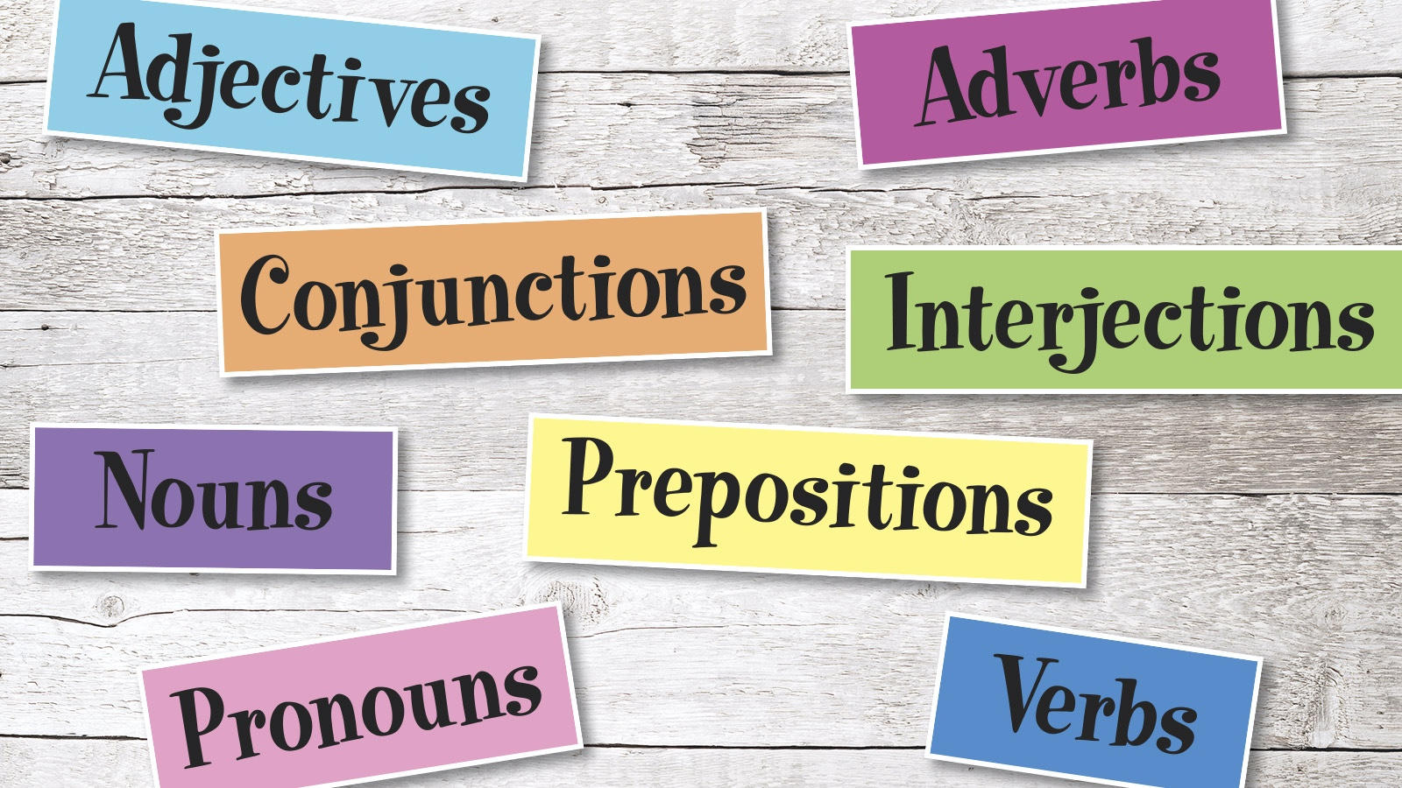
Objective: To apply the rules to transform an adjective into an adverb.
Adjectives describe nouns
Adverbs describe verbs

Slide 5
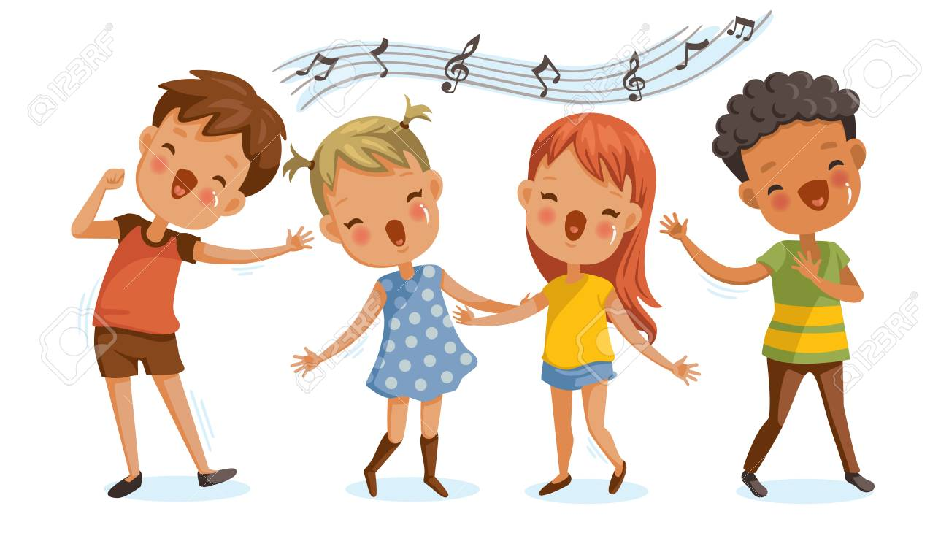
Adverbs and adjectives
We use _________ to describe people, thing,
places, animals, concepts, etc
We use __________ to describe actions
They sing happily
He is a happy man

Slide 6
Adjectives into adverbs
Rule 1.- In a large number of the cases, the adverb can be formed by simply adding ‘-ly’ to the adjective.
Adjective | Adverb
Cheap
Quick
Strong
Sudden
Special

Slide 7
Adjectives into adverbs
Rule 2.- If the adjective ends in with ‘y’, replace the ‘y’ with an ‘i’ and add ‘-ly’.
Adjective | Adverb
Ready
Hungry
Easy
Crazy
Happy

Slide 8
Adjectives into adverbs
Rule 3.- If the adjective ends with ‘-le’, replace the ‘e’ at the end with ‘y’.
Adjective | Adverb
Understandable
Forcible
Possible
Terrible
Comfortable

Slide 9
Adjectives into adverbs
Rule 1.- If the adjective ends with ‘-ic’, add ‘-ally’.
Adjective | Adverb
Idiotic
Tragic
Basic
Ironic
Realistic

Slide 10
Let’s add some words to our vocabulary list
Cheap
Quick
Strong
Sudden
Special
Ready
Hungry
Crazy
Easy
Happy
Understandable
Forcible
Possible
Terrible
Comfortable
Idiotic
Tragic
Basic
Ironic
Realistic

Slide 11
Let’s complete the sentences
1.- I ______ realized what I’d said, but it was too late.
2.- They found a way to make clothes more _______.
3.- They sat down and ate ______.
4.- I can _____ be home early tonight if you want.
5.- I slept __________ last night.
6.- Are you sitting ____________?
7.- The two cars are ________ the same.
8.- ________, many people died in the accident

Slide 12
Let’s complete the sentences
1.- I suddenly realized what I’d said, but it was too late.
2.- They found a way to make clothes more cheaply
3.- They sat down and ate hungrily.
4.- I can easily be home early tonight if you want.
5.- I slept terribly last night.
6.- Are you sitting comfortably
7.- The two cars are basically the same.
8.- Tragically, many people died in the accident

Slide 13
____ are used to describe
1) Adverbs
2) Adjectives
3) Adjectives and adverbs
4) Verbs

Slide 14
Adjectives are used to describe _________
1.- Animals
2.- People
3.- Places
4.- 1, 2 and 3

Slide 15
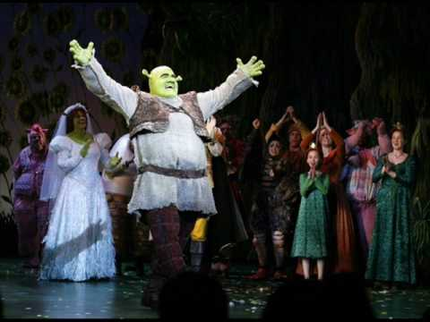
Nice job!
Your awesome job and participation made shrek happy!
See you next class!

